Slide 1

Nathalie Balduck nathalie.balduck@champittet.ch

Slide 2

EDpuzzle is an incredible-easy-to-use video platform that helps teachers save
time, boost classroom engagement and improve student learning.
EDpuzzle also collects data as students watch and interact with the video.
It’s completely free!

Slide 3
Videos
Take any video from YouTube, Khan Academy, …
Re-use other teachers’ video-lessons from EDpuzzle amazing video-collection.
Upload your own videos directly from your computer or iPad.

Slide 4
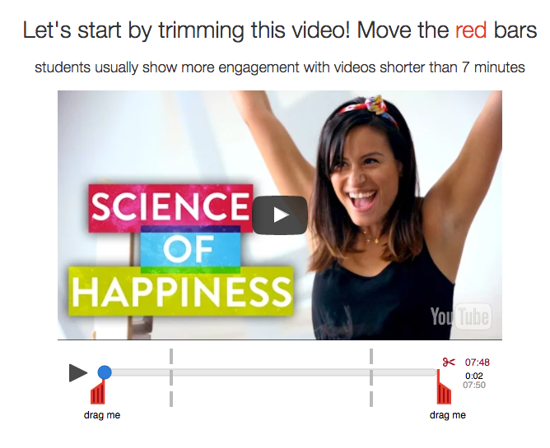

Slide 5
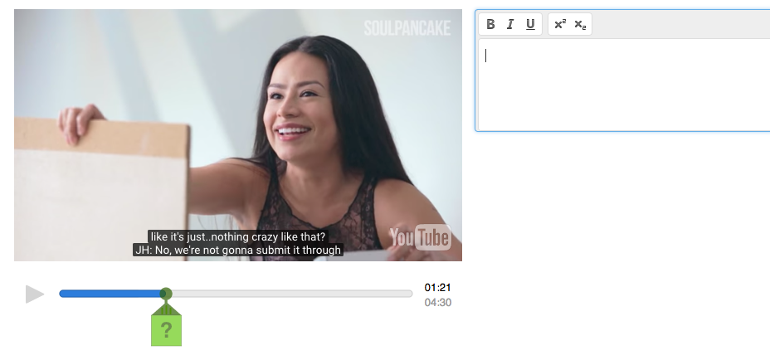

Slide 6
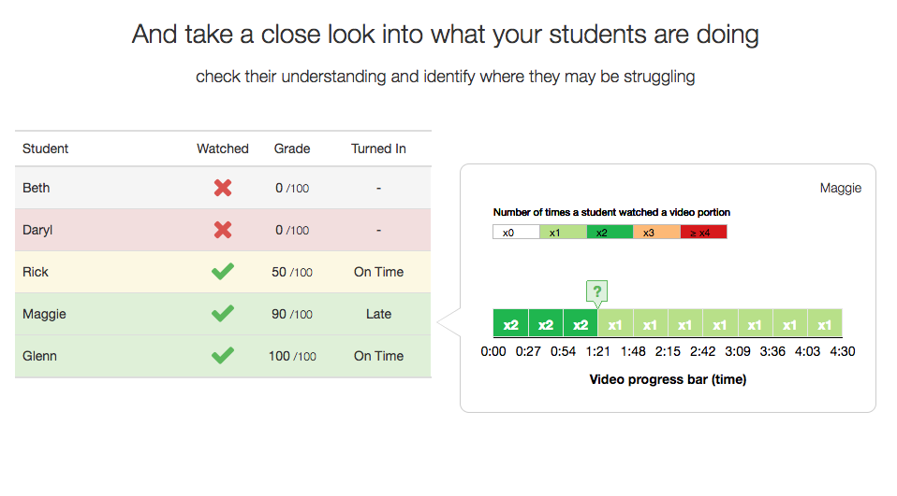

Slide 7
Extra
Record your voice to explain it in your own personal way, add clarifications, a warm introduction, …

Slide 8

Example EdPuzzle 1
http://bit.ly/2qWNz9V

Slide 9
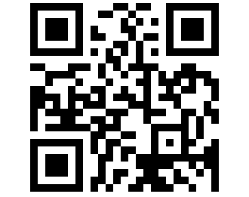
Example EdPuzzle 2
http://bit.ly/2pVKmtY

Slide 10
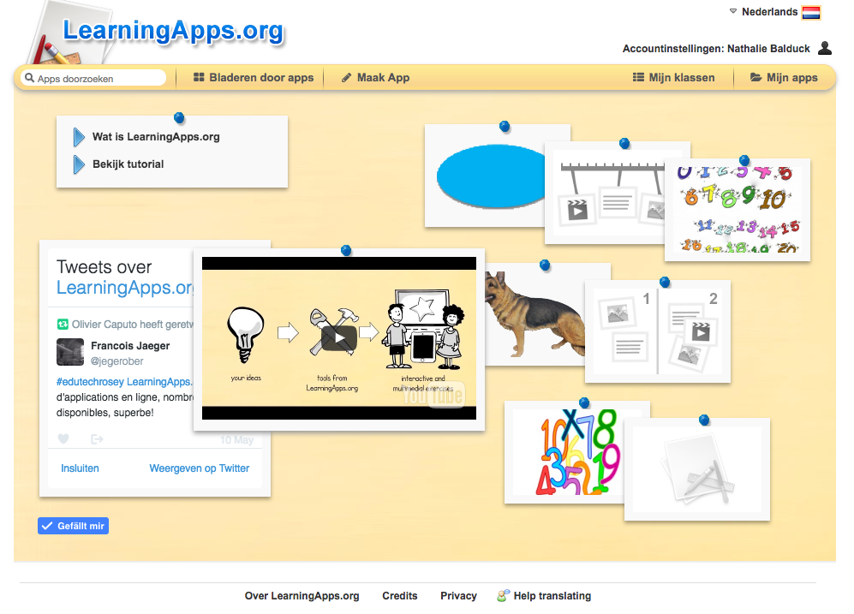
learningapps
learningapps.org

